Slide 1


Effect of Camera Use in Online Learning on Participant Performance
Presented to you by:
Aithal, Mukunda
Cheng, Yifan
Huang, Cindy
Sembiring, Monika
Wang, Kelly

Slide 2
EXECUTIVE SUMMARY
Background
Popularity of online learning and its potential to sustain.
No related research of turning video on in online learning on with result of learning.
Problem Statement
Does having the video on and being recorded during online learning affect participant learning?
Approach
Data preprocessing
Regression to get four level causal effect
Findings
The results are not statistically significant ~ no causal effects.
Insignificance due to limited data that explains attention.
Recommendations
Incorporate more data on covariates that explain attention.
Recruit more participants to collect more data for higher power of study.
Background
Problem Statement
Approach
Findings
Recommendations

Slide 3



BACKGROUND & MOTIVATION
Online learning had already been on the rise (Seaman et al., 2018), but the pandemic catalyzed this trend.
In June of 2020, more than 700 universities were holding classes online using the video communication platform Zoom (Kostadin et al., 2022)
Even as quarantine restrictions are being lifted, there is a general consensus that virtual learning platforms will remain an indispensable educational tool (George et al., 2021)
Background
Problem Statement
Approach
Findings
Recommendations

Slide 4

BACKGROUND & MOTIVATION
Existing Related Study
Only focus on relationship between camera on and engagement.
Lights, Cameras (On), Action! Camera Usage During Zoom Classes Facilitates Student Engagement Without Increasing Fatigue (Kushlev & Epstein-Shuman, 2022)
Student Visibility’s Relationship to Distractibility: How Cameras Affect Engagement in Online Classes (Kessler et al., 2021)
Picturing One’s Self: Camera Use in Zoom Classes during the COVID-19 Pandemic (Li et al., 2022)
How does having the video on and being recorded during online learning affect participant learning?
Our analysis is unique because it assesses the causal effects of a learner being recorded on camera while watching an instructional video on their understanding of the concepts taught in video.
Background
Problem Statement
Approach
Findings
Recommendations

Slide 5
PROBLEM STATEMENT
1
Does the requirement to use their camera have a causal effect on a participant’s learning?
2
Does the decision to turn on their camera have a causal effect on a participant’s learning?
3
Does having camera on for at least 40% of the video duration have a causal effect on a participant’s learning?
4
Is there any different causal effect for the groups with and without prior knowledge on the concept taught?
Background
Problem Statement
Approach
Findings
Recommendations

Slide 6
PROJECT METHODOLOGY
Received the dataset as CSV file
Define well recorded video
Define subgroups based on pre quiz score
Implemented the analysis
Background
Problem Statement
Approach
Findings
Recommendations

Slide 7
PROJECT METHODOLOGY
1
Intention-to-treat (ITT)
y ~ T + additional controls
with:
y = number of correct answer from quiz after the video
T = prompt to turn on the camera and enable recording while watching the video
additional controls = correct answer for quiz before video, duration to finish the survey, gender, race, and ID of the video watched
Background
Problem Statement
Approach
Findings
Recommendations

Slide 8
PROJECT METHODOLOGY
2
Local Average Treatment Effect (LATE)
ivreg(y ~ X|T + additional controls)
with:
y = number of correct answer from quiz after the video
X = participant actual decision to have camera on and be recorded
T = prompt to turn on the camera and enable recording while watching the video
additional controls = correct answer for quiz before video, duration to finish the survey, gender, race, and ID of the video watched
Background
Problem Statement
Approach
Findings
Recommendations

Slide 9
PROJECT METHODOLOGY
3
LATE within LATE
ivreg(y ~ X|T + additional controls)
with:
y = number of correct answer from quiz after the video
X = whether the participant has their video on and being recorded for at least 40% of the entire video (> 120 seconds)
T = participant actual decision to have camera on and be recorded
additional controls = correct answer for quiz before video, duration to finish the survey, gender, race, and ID of the video watched
Background
Problem Statement
Approach
Findings
Recommendations

Slide 10
PROJECT METHODOLOGY
4
LATE with Heterogeneous causal effect
ivreg(y ~ X + G + X:G|T + G + T:G + additional controls)
with:
y = number of correct answer from quiz after the video
X = whether the video on and recorded for at least 40% of the video (> 120 seconds)
G = indicate group that answered all pre-quiz correct vs. group that did not
T = participant actual decision to have camera on and be recorded
additional controls = correct answer for quiz before video, duration to finish the survey, gender, race, and ID of the video watched
Background
Problem Statement
Approach
Findings
Recommendations

Slide 11
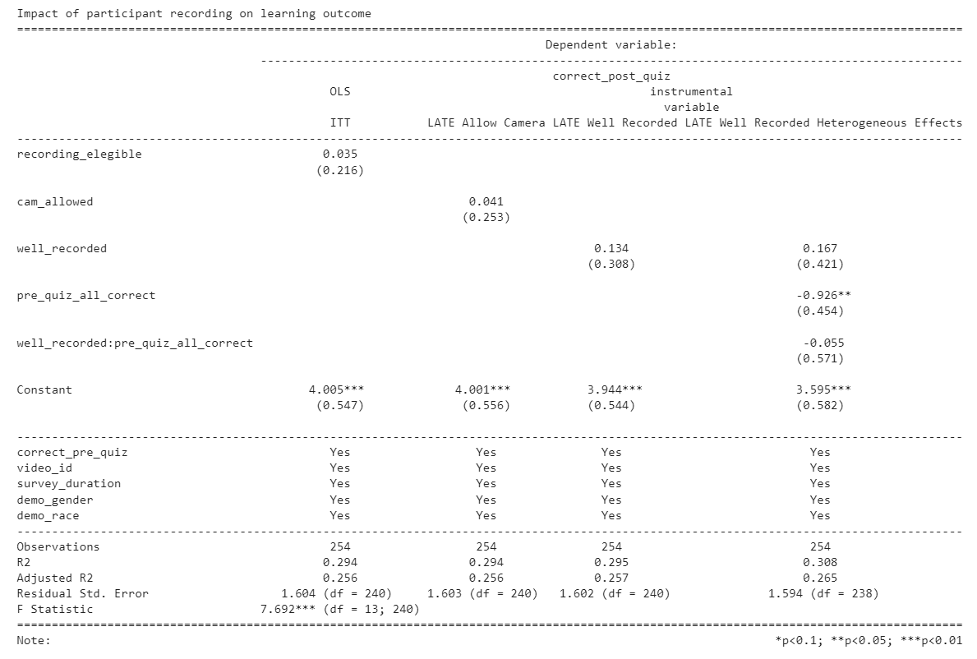
REGRESSION: OVERALL CAUSAL EFFECTS
Camera Requirements: No causal effect
Allow Camera:
No causal effect
3
1
2
Camera on for > 120s:
No causal effect
4
No heterogeneous causal effect
Background
Background
Problem Statement
Problem Statement
Approach
Approach
Findings
Findings
Recommendations
Recommendations

Slide 12


LESSON LEARNED
Recording duration might not explain attention well.
Even though the result is not statistically significant, this analysis can be a baseline for future studies.
Background
Background
Problem Statement
Problem Statement
Approach
Approach
Findings
Findings
Recommendations
Recommendations

Slide 13


FUTURE RECOMMENDATIONS
Attention Level
Collect data that explain attention level better such as eye movement along the material in the screen.
Sample Size
Recruit more participants to collect more data for higher power of study.
Background
Background
Problem Statement
Problem Statement
Approach
Approach
Findings
Findings
Recommendations
Recommendations

Slide 14
THANK YOU

